Slide 1
[Meme Title: Cooking Up a Plan] [Srs Bsns Title: Task Planning for the Game Overcooked]
Roger Liu, Stephen Chen

Slide 2
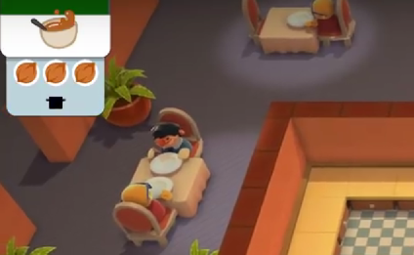
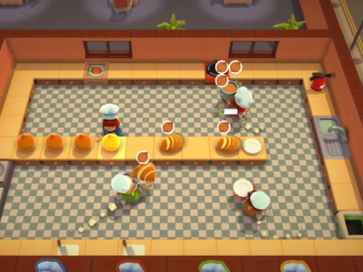
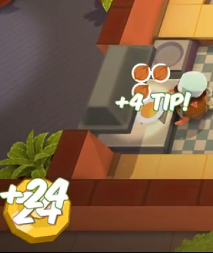
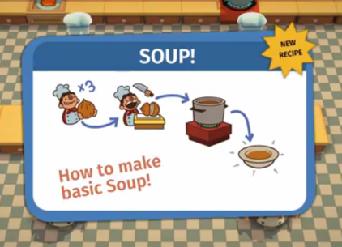
What is Overcooked?
Overcooked is a cooperative cooking game
Players control chefs and prepare meals for incoming orders in real-time.
Creating a meal following involves a series of steps.
Completing meals faster rewards more points.
Complete Meals
Follow Recipes
Get Orders
Organize Tasks

Slide 3
Related Work
Symbolic planning
Planning with Multiple Agents

Slide 4
Approach
Create a simplified version of Overcooked as our test environment
Use symbolic planning to have a single agent process single orders
Create plans that satisfy multiple orders coming at different times, even when there are no outstanding orders
Potential Extension: Run a centralized, multi-agent planner for at least 2 agents

Slide 5
Metrics of Success
Speed of computing viable plans
Optimality of the plan. Is the planner able to come up with a better plan than a human player.
In the case of 2 agents, can the planner improve its score in a significant way

